Slide 1

PROJECT NAME
SECRET OF HAPPINESS
GROUP MEMBERS
FATIN ISHRAK RAHMAN,19-39862-1
JEBA FAWJIA,19-39815-1
FATHEMA AKTER MOONMOON,19-40161-1
FAHAD BIN AHMED,19-41719-3

Slide 2

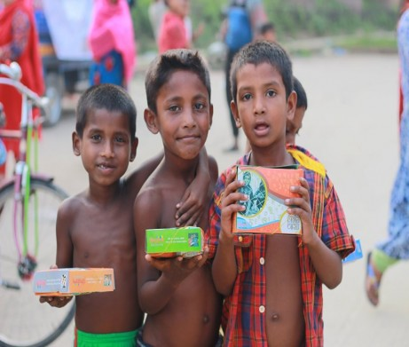
BESIC FUNCTIONALITY
Offers assistance to individuals and families in need.
Based on social helping and emergency response.
The advancement of social and community welfare.

Slide 3

DATA ANALYSIS & INTERPRETATION
Provide impactful activities- food stamp, funds raising,donation,awareness campings,blood donation,winter cloth distribution,flood relief cmpaingn.
Created for searching purpose and to decrease people’s need.
Best option for those people who interested for donating and assistance.

Slide 4


OBJECTIVES
The goals are to increasing social development ,ensure healthy lives and connecting huge community in a small.
To motivate youth and volunteers who can involve themselves in the aims,objectives and goals of the social welfare.
To shape the goals with public ,private,organigation and NGO’s.

Slide 5

CHALLENGES
Create social response to a changing thinking and build financial capability.
Ensuring quick response on any emergency.

Slide 6

SCOPE
Different organigation,NGO’s and social stakeholders can contribute.
Scope for removing unemployment.
To make communication with national and international platform.

Slide 7
Thank You

